Slide 1
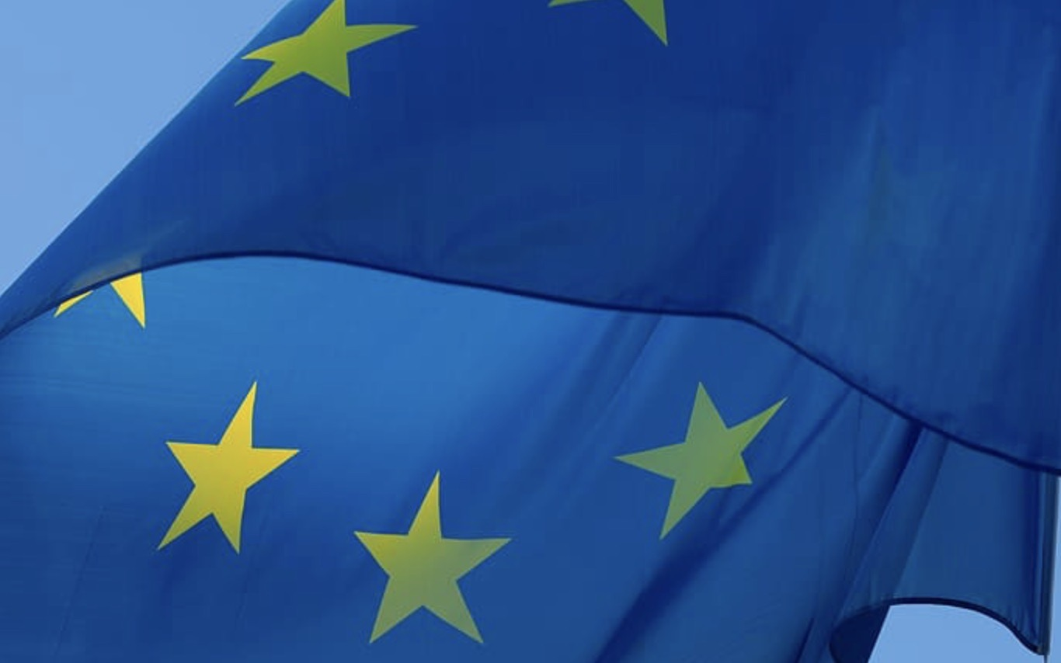
ROLE OF THE EU AND ITS PERCEPTION
Research Report
2021

Slide 2
content
Context and objectives of the research
Methodology
Research conclusions
Main findings
Project team

Slide 3
Context and objectiveS

Slide 4

Context and objectives of the research
Currently, number of studies are available that have been focused on overall evaluation of the EU as an institution by citizens of Czech Republic. Attitudes towards the EU has been continuously measured by organizations like Eurobarometr or CVVM. Yet majority of studies have only measured the overall sentiment towards EU and paid insufficient attention to particular provisions, benefits and the role of EU. Main objective of this research is to evaluate the role of EU from the perspective of an ordinary citizen. The research aims to explore how specifically are Czech citizens aware of EU projects in their immediate surroundings and their consequences for them, which also measure their conscious perception of the EU.

Slide 5
methodology

Slide 6
Questionnaire distributed across Perfect Crowd‘s panel of respondents (30 000 registered members).
Sample
COUNTRY
TARGET GROUP
SAMPLE(PRG AND CZ)
COMPLETION TIME
CZ
general Czech voter population from 18 to 70 years old/representative sample based on sex, age, education and size of municipality and region
N(PRG) = 500
N(CZ) = 500
median = 25 min

Slide 7
Research conclusions

Slide 8

Global-scale topics should be addressed mainly on the national level
RESEARCH CONCLUSIONS
Even when we sorted by variables such as voting behaviour or demographics, we didn‘t find any particular group in Czech population that would declare that we should address the key global topics mainly through European union.
At least since joining the European union, Czech population shows a growing tendency towards localization at the expense of globalization. This finding may be one of it‘s consequences.

Slide 9
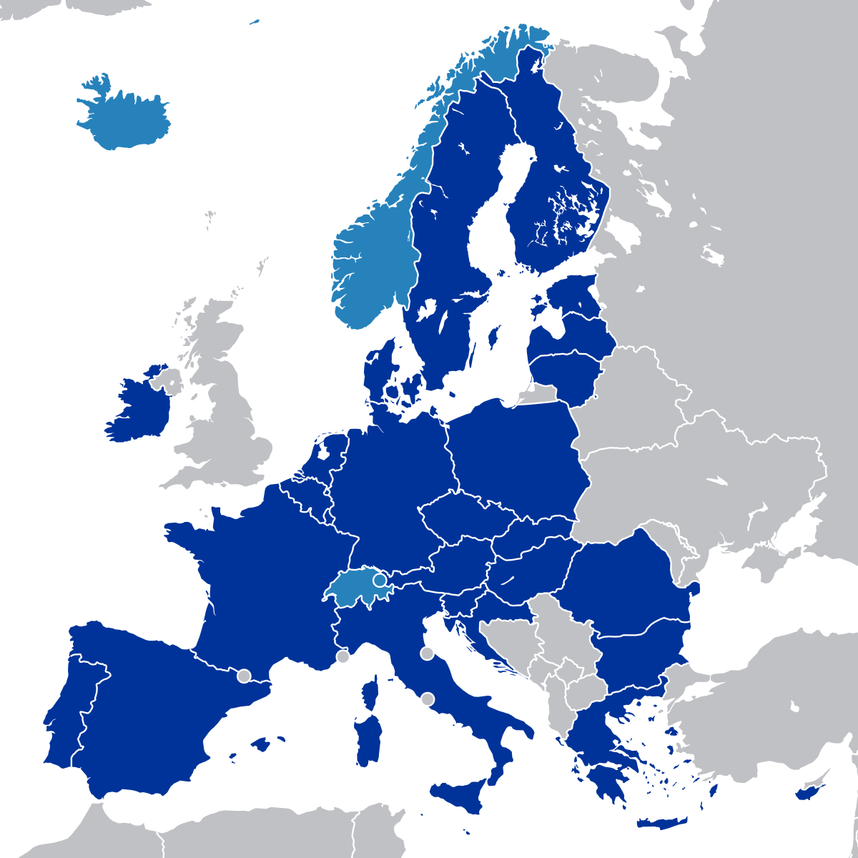
Main percieved benefits from EU membership stayed the same during pandemic
RESEARCH CONCLUSIONS
The „Four freedoms“ of European single market (and subsidies) scored as top main benefits from our membership (also significantly more valued in Prague population than in Czech population).
Even tough restrictions in Czech Republic had been limiting the major benefits of EU membership, people still recognize their value.

Slide 10


Czech and Prague population differ only in particular topics
RESEARCH CONCLUSIONS
We didn‘t identify strong differences between Czech and Prague population and when we did, It was rather determined by the way of spending European funds in their surroundings or by degree of individual Euroscepticism, not by structural differences.
The only one strong difference between those populations is in their belief in the future of EU: 55% of Prague population believes that EU will exist twenty years from now, while in Czech population it is only 36%.

Slide 11
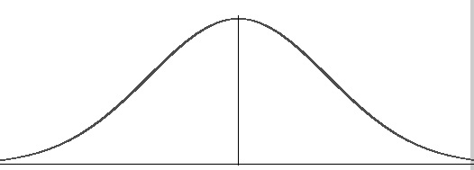
Dealing with left and right wing extremism
RESEARCH CONCLUSIONS
Only one in five in Czech republic views positively the approach of EU with dealing with left and right wing extremism, which is significantly the worst score among all eight topics.
On the other hand, one in two in Czech republic views positively the approach of EU with terrorism and security. From our point of view, It could be interpreted as delineation against political ideologies, which are generally stigmatized in Czech republic.

Slide 12
rECOMMENDATIONS

Slide 13

Awareness of EU projects does not affect how we perceive the EU. EU could focus on local humanitarian aid.
Recommendations
Awareness of EU projects does not affect how we perceive the EU. For example it is quite well visible that Prague citizens are aware of the EU project in their surrounding is similar manner as the rest of the country. That‘s why we would recommend to rely on the fact that people are aware of the EU project in their neighbourhood.
Both respondents from Prague and respondents from Czech Republic appreciated role of the EU in a humanitarian aid and in ecology. In cases in which EU helps local people in need it is hard to blame EU.
The role of EU could be perceive better if EU would help in urgent and serious cases. Not only current pandemic generate such opportunities but poverty or bad ecological situation in particular regions (Ostrava, Ústí nad Labem) too.

Slide 14
The ideal archetype of MEP
RECOMMENDATIONS
Ideal MEP, according to the respondents, should be someone who is able to transfer his experience to the EU and at the same time will proactively seek opportunities for his country.
Current key benefits of MEP are :
His/her experiences in politics
Ability to use its presence in the heart of the EU to help to promote subsidies for investment in his/her area.
The ideal narrative of an MEP is
I know languages and I am well oriented within the organization of the EU. This will allow me to get more from our EU membership for our country / region.

Slide 15
Main findings

Slide 16
Interest in public affairs AND TO VOTE

Slide 17
declared interest in public affairs
Prague is more cosmopolitan
As expected, population from Prague tends to be more interested in foreign affairs and to follow the news on daily basis.
We are going to introduce you to various statements in order to find out to what extent you are interested in public affairs/events, politics and the world around you. For each statement, please choose the most fitting answer.

Slide 18
PREVIOUS VOTING AND DECLARED INTEREST TO VOTE
Did you take part in the last
European Parliament
elections (2019)?
Did you take part in the last
elections to the Chamber
of Deputies (2017)?
Imagine that the elections to
the Chamber of Deputies would take place next week.
Would you take part in the elections?
Biased by self-reporting
We have to take into account two major facts over here – social desirability and self-reporting. Both have an impact on the results as respondents don‘t want to look badly even to themselves.
Did you take part in the last European Parliament elections (2019)? Did you take part in the last elections to the Chamber of Deputies (2017)? Imagine that the elections to the Chamber of Deputies would take place next week. Would you take part in the elections?

Slide 19
OTHER POLITICAL PARTIES CONSIDERED
Inclining to liberalism
While half of the respondents don‘t know who to vote for if they wouldn‘t vote their first choice with decisive certainity, there has been strong connection to liberalism in case of second and other choices within czech political landscape.
As you would not have chosen the party with decisive certainty….What would the other parties you would take into consideration be?

Slide 20
Self-perception on the left/right scale
Weak connection to the public affairs interest
While the left/right political views are based on numerous strong factors, as we can see, it‘s not necessarily linked to the degree of interest in public affairs.
Politics is often about the right and left wing issue. Where would you see yourself on this scale?

Slide 21
PERCEPTION OF EU

Slide 22
Perception of THE EU on the left/right scale
Negative association with the left
If the respondents tend to view themselves as eurosceptics, they are more often declaring that EU is rather leftist.
And where would the European Union as such on this scale be?

Slide 23
BELIEF IN THE FUTURE OF EU
Prague has stronger belief in the future of EU
Only approximately third of czech population believe that EU will exist twenty years from now in comparison to more than half of prague population. This may indicate that people in bigger cities are more aware of the benefits of EU membership and tend to believe more in the stability of the EU project.
Do you think that in 2040 the European Union will still exist?

Slide 24
Belief in the future of eu based on age
Intergenerational conflict
The fact that age cohort from 18-24 show the least interest in public affairs generally is interesting in context with this graph - the only majority from the age cohorts that declares their belief in the future of the EU is the youngest one. On the other hand, belief in the future of EU is quite alarming for the senior‘s cohorts.
Do you think that in 2040 the European Union will still exist?

Slide 25
Number of states of eu in the future based on public affairs interest
Evolving/established
Those who show higher interest in public affairs view the EU more as continuously evolving project, while those with lower interest view the EU as established institution with higher degree of uncertainity in case of the number of states.
Do you think that in 2040 the EU will have more or fewer member states than it has now?

Slide 26
Integration/separation of the States
4 out of 5 doesn‘t expect to EU loose it‘s power
People may believe that EU won‘t exist in the future, but if it will, it is unlikely for people to imagine that there will be a reform that will cause strengthening the powers of nation states.
And do you think that by 2050 there will have been higher integration and strengthening of the European Union, or, conversely, strengthening the powers of nation states will have occurred?

Slide 27
Integration/SEGREGATION BASED ON PUBLIC AFFAIRS INTEREST
What to expect?
Respondents with higher index of public interest expect from EU to strenghten the process of integration, but those with lower interest do not necessarily expect to strenghten the process of segregation. They are rather in favor of status quo or they don‘t know.
And do you think that by 2050 there will have been higher integration and strengthening of the European Union, or, conversely, strengthening the powers of nation states will have occurred?

Slide 28
PERCEPTION OF EU MEMBERSHIP AND ITS BENEFITS

Slide 29
main benefits of the eu membership
Main benefits stayed the same
Even tough restrictions in Czech Republic had been limiting the major benefits of EU membership (travel, single market), people still recognize their value.
Please list all the benefits that the Czech Republic's EU membership has brought, if you perceive any:

Slide 30
main benefits of eu membership BASED ON LEFT/RIGHT SCALE AND OPT/REA/PES VIEWS
Pro-market politics are the right european values
The three most scoring benefits in the form of open question have been also declared more often by right-wings respondents.
Please list all the benefits that the Czech Republic's EU membership has brought, if you perceive any:

Slide 31
Main drawbacks of the eu membership
Czech myth about bureaucracy
Czechs tend to believe that complex systems don‘t require highly organized structures. This contradiction is often seen in the communication towards public by political parties: The state will work better under our leadership, but at the same time, we will reduce bureaucracy and the number of employees in public sector.
Please list all the drawbacks that the Czech Republic's EU membership has brought, if you perceive any:

Slide 32
Main drawbacks of the eu membership BASED ON LEFT/RIGHT SCALE AND OPT/REA/PES VIEWS
Right wing patriots
Altough right-wing respondents recognizing the main benefits more often than others, they are also the most homogenous and the most critical group in terms of main drawbacks of the EU membership.
Please list all the drawbacks that the Czech Republic's EU membership has brought, if you perceive any:

Slide 33
profession of the eu as a person
Representative of the bureaucracy
In accordance with previous findings, Czechs often imagine the EU as a bureaucracy with emphasis on knowledge of law and processes. Minor part of the public sees the EU as service-related profession.
Please imagine that the European Union would become a human and want to apply its best qualities and skills. What profession do you think she/he would represent?

Slide 34
sentiment of PERCIEVED information about eu During past six months
More people had seen negative news
Although the EU has done unprecedented action in response to the coronavirus, people had more likely seen negative news than positive news. This is consistent with the findings that during the pandemic, the disinformations have raised on social and other media channels.
Please try to recall all the pieces of news and information you have received about the EU over the last six months. How did you usually feel about such message or piece of information?

Slide 35
EU projects in my area

Slide 36
awareness of eu-funded projects
In the consciousness
Vast majority have seen the information about EU-funded projects in their surroundings.
Please try to think about and specify how many times you have seen the sign "Supported by European Union funds" in your area:

Slide 37
how many projects do respondents know
Splitted into thirds
It‘s quite interesting that third of respondents who saw a sign with information of „EU-funded project“ are unaware of any specific project. We do know what EU is doing for us, but we cannot connect it with concrete iniciatives.
Are you aware of any construction, repair or project in your area that has been funded by the European Union funds?

Slide 38
which kind of eu-funded Projects do respondents know
EU is replacing the state
As we can see, Prague population is significantly more aware of EU benefits in quartal sector as well as in case of awareness of improvements in public space.
And what areas did this construction, repair or project cover? Please select all areas affected:

Slide 39
which kind of eu-funded Projects DO R. KNOW BASED ON THE VOTE FOR COALITION/OPOSITION
EU impact is more recognized by the opposition
Respondents who vote for the opposition political parties are recognizing the impact of EU more in areas that are the targets of current criticism towards the coalition (infrastructure, education and cultural facilities). Coalition voters identify the impact of EU significantly more in secondary sector (retraining and industry).
And what areas did this construction, repair or project cover? Please select all areas affected:

Slide 40
Open question – particular areas
Reconstructions have the most visibility
Please list the specific construction, repair or name of the project you are aware of and which has been funded by the European Union funds in the area

Slide 41
In which areas could eu improve my WELL-BEING
Postindustrial values
When we ask respondents what could the EU do to improve their lives, half of them don‘t know what to ask for.
And what other areas where the EU would improve your life, work, education or leisure activities for you or your loved ones do you know?

Slide 42
trust in spending of municipalities
European funds are spent efficiently
Only one person from seven people do not believe that their municipality representatives are spending the money from EU efficiently.
Municipalities often use co-financing from the European Union funds. Do you think that these funds are spent efficiently and for the benefit of your community in your area?

Slide 43
EFFORTS OF EU TO TACKLE INEQUALITIES
Divided on inequalities
We are divided into two opposing groups – one does feel that EU has positive impact to their surroundings and tackling the inequalities between regions well, while the other half not.
One of the European Union's key efforts is the reduction of inequalities between the Member States, but especially between regions within individual countries. Do you feel that this effort is reflected in your life and surroundings in some way?

Slide 44
ANTICIPATED EU BENEFITS

Slide 45
Expectations from the eu
Two thirds are in favor of referendums
Direct democracy is an important topic in the Czech republic, even in contrast to the fact that we have one of the lowest voter turnouts in the whole EU. This finding may be part of the bigger issue – Czech republic doesn‘t have a crucial voice or impact within the EU in the eyes of the public as we can see from the most agreed statement. Czech interests are not the same as EU interests.
In this part of the questionnaire, we will present to you the statements made by people in connection with their expectations as for the European Union. For each, please tick whether you agree or disagree.

Slide 46
„Membership in the Schengen area is one of the main benefits for our country.“
Opposition voters for the Schengen area
This could be linked to the more cosmopolitan/liberal nature of opposition voters.
In this part of the questionnaire, we will present to you the statements made by people in connection with their expectations as for the European Union. For each, please tick whether you agree or disagree.

Slide 47
„Our country benefits from the European Union's subsidy policy system.“
Agreed to disagree
Three key voters group of political parties (when we consider their profilation: Main coalition party – ANO, main opposition party – Pirates and main anti-establishment party – SPD) and their views on the european subsudy policy systém.
If you went to the polls, which side, or coalition of parties would you probably vote for? In this part of the questionnaire, we will present to you the statements made by people in connection with their expectations as for the European Union. For each, please tick whether you agree or disagree.

Slide 48
IDEAL MeP CONCEPT TEST

Slide 49
The MAp OF AN ideal MEP
WHAT MEP DOES BUT SHOULD NOT
KEY BENEFITS OF MEP
WHAT MEP DOES NOT AND SHOULD NOT
MISSING BENEFITS OF MEP
In this chapter, we will focus on your ideas as for an ideal MP. For each characteristic presented on a ten-point scale, please indicate to what extent you consider it important for an ideal MP; and at the same time, please indicate whether, in your opinion, the current Czech MPs mostly represent/fulfill such characteristics. The ideal MP…..

Slide 50
KEY BENEFITS OF MEP
Current key benefits of MEP are his experiences in politics and ability to use its presence in the heart of the EU to help to promote subsidies for investment in his/her area.
In this chapter, we will focus on your ideas as for an ideal MP. For each characteristic presented on a ten-point scale, please indicate to what extent you consider it important for an ideal MP; and at the same time, please indicate whether, in your opinion, the current Czech MPs mostly represent/fulfill such characteristics. The ideal MP…..

Slide 51
MISSING BENEFITS OF MEP
Respondents consider that MEPs do not articulate people’s interest within the EU. However there is a visible demand for MEPs that play role of a medium between the EU and citizens.
In this chapter, we will focus on your ideas as for an ideal MP. For each characteristic presented on a ten-point scale, please indicate to what extent you consider it important for an ideal MP; and at the same time, please indicate whether, in your opinion, the current Czech MPs mostly represent/fulfill such characteristics. The ideal MP…..

Slide 52
WHAT MEP DOES BUT SHOULD NOT
Respondents do not appreciate much when MEPs comment other countries.
In this chapter, we will focus on your ideas as for an ideal MP. For each characteristic presented on a ten-point scale, please indicate to what extent you consider it important for an ideal MP; and at the same time, please indicate whether, in your opinion, the current Czech MPs mostly represent/fulfill such characteristics. The ideal MP…..

Slide 53
WHAT MEP DOES NOT AND SHOULD NOT
MEP should promote people not a country.
In this chapter, we will focus on your ideas as for an ideal MP. For each characteristic presented on a ten-point scale, please indicate to what extent you consider it important for an ideal MP; and at the same time, please indicate whether, in your opinion, the current Czech MPs mostly represent/fulfill such characteristics. The ideal MP…..

Slide 54
The ideal MEP
 | Czech Republic |  | Prague
 | importance | fulfilling | importance | fulfilling
should have a perfect command of at least one foreign language. | 8,8 | 6,6 | 8,9 | 6,7
should explain the views of their own citizens to the rest of Europe so that the peoples of the EU can understand them better. | 8,3 | 5,1 | 8,4 | 5,1
should be aware of the issues of their country, or region in detail and strive to address them at the EU level. | 8,1 | 5,3 | 8,4 | 5,6
should advise and help citizens and businesses in their country on how to make the most of EU membership. | 8,1 | 5,1 | 8,2 | 5,0
should address the issues of their own country which go beyond the capabilities of one country, such as danger/threat from other countries, climate change. | 8,0 | 5,4 | 8,3 | 5,3
should have already had some experience with politics and know how politics works. | 7,9 | 6,0 | 8,2 | 6,3
should, based on knowledge of how the EU projects work, help to promote subsidies for investments in their area. | 7,9 | 5,5 | 7,9 | 5,5
should clearly and measurably demonstrate their activity, e.g. by the number of proposals submitted, the number of votes or the intelligence level. | 7,8 | 5,0 | 7,9 | 5,0
should meet the citizens of their own country in person. | 7,7 | 5,1 | 7,6 | 4,9
should be responsible for how the European Union is perceived by the Czech nation. | 7,6 | 5,3 | 7,7 | 5,1
should have a legal-oriented education in order to be able to get their head round in the legislative process. | 7,5 | 5,5 | 7,8 | 5,7
should be accountable to Czech citizens to the same extent as it should be accountable to citizens of other member states. | 7,5 | 5,4 | 7,4 | 5,4
should be interested in successes in other countries and try to promote them in their own country. | 7,3 | 5,3 | 7,5 | 5,1
should have already achieved success in the private or public sector. | 6,5 | 5,5 | 6,1 | 5,5
should also address and comment on other countries, such as Belarus or Hungary. | 6,2 | 5,7 | 6,5 | 5,5
should be active on social networks. | 5,9 | 5,8 | 6,1 | 5,7
should promote the European principles, even at the cost of creating conflict in the country for which they were elected. | 5,4 | 5,4 | 5,3 | 5,3
Voice of the people
The ideal MEP should be fluent in the foreign language and should know his country and its citizens. Previous experience in private life or advocating for european values doesn‘t matter that much. According to the public, our MEP‘s are the worst in the demonstrating their activity to the public.
In this chapter, we will focus on your ideas as for an ideal MP. For each characteristic presented on a ten-point scale, please indicate to what extent you consider it important for an ideal MP; and at the same time, please indicate whether, in your opinion, the current Czech MPs mostly represent/fulfill such characteristics. The ideal MP…..

Slide 55
Spontanneous AWARENESS of mps
Czech european commissioner is the second most known MEP
4 in 10 respondents do not know any MEP, while spontanneus knowledge of Stanislav Polčák is on the verge of statistical error.
Please list the names of all Czech and foreign MPs you can recall:

Slide 56
PROMPTED AWARENESS of meps of their work
Recall of the nineties
Most known MEPs are the right-wing politics who had been on the political scene for more than 30 years. Respondents are quite little familiar with the representatives of new political subjects – SPD and Pirate party. 7 in 10 respondents don‘t know Stanislav Polčák at all.
There is a list of candidate leaders and the most famous Czech MPs. For each, please specify if you know him / her.

Slide 57
stanislav polčák /interest in public affairs
High interest/high recognition
If the respondents don‘t show interest in public affairs, there is almost zero chance that they will know Stanislav Polčák.
There is a list of candidate leaders and the most famous Czech MPs. For each, please specify if you know him / her.

Slide 58
Would vote for Stanislav polčák/fulfillMENT Of such characteristics of the role mep
 | Total CR N1010 | 1,2 – Would never vote for Stanislav Polčák N425 | 4,5 – Would happily vote for Stanislav Polčák N180
should have a perfect command of at least one foreign language. | 6,6 | 6,2 | 6,5
should explain the views of their own citizens to the rest of Europe so that the peoples of the EU can understand them better. | 5,1 | 4,5 | 5,5
should be aware of the issues of their country, or region in detail and strive to address them at the EU level. | 5,3 | 4,8 | 6,0
should advise and help citizens and businesses in their country on how to make the most of EU membership. | 5,1 | 4,6 | 5,4
should address the issues of their own country which go beyond the capabilities of one country, such as danger/threat from other countries, climate change. | 5,4 | 4,9 | 5,7
should have already had some experience with politics and know how politics works. | 6,0 | 5,5 | 6,5
should, based on knowledge of how the EU projects work, help to promote subsidies for investments in their area. | 5,5 | 5,0 | 5,7
should clearly and measurably demonstrate their activity, e.g. by the number of proposals submitted, the number of votes or the intelligence level. | 5,0 | 4,5 | 5,2
should meet the citizens of their own country in person. | 5,1 | 4,5 | 5,4
should be responsible for how the European Union is perceived by the Czech nation. | 5,3 | 4,9 | 5,6
should have a legal-oriented education in order to be able to get their head round in the legislative process. | 5,5 | 5,0 | 6,2
should be accountable to Czech citizens to the same extent as it should be accountable to citizens of other member states. | 5,4 | 4,9 | 5,8
should be interested in successes in other countries and try to promote them in their own country. | 5,3 | 5,1 | 5,4
should have already achieved success in the private or public sector. | 5,5 | 4,9 | 6,2
should also address and comment on other countries, such as Belarus or Hungary. | 5,7 | 5,2 | 6,1
should be active on social networks. | 5,8 | 5,4 | 6,0
should promote the European principles, even at the cost of creating conflict in the country for which they were elected. | 5,4 | 5,0 | 5,6
Archetype of european patriot
Respondents who would vote for Stanislav Polčák are more personality – oriented (should be experienced in politics and achieved success in private life) and views the czech MEP‘s work more positively.
In this chapter, we will focus on your ideas as for an ideal MP. For each characteristic presented on a ten-point scale, please indicate to what extent you consider it important for an ideal MP; and at the same time, please indicate whether, in your opinion, the current Czech MPs mostly represent/fulfill such characteristics. The ideal MP…..

Slide 59
KEY TOPICS

Slide 60
Major topics and where they should be adressed
KEY OF IMPORTANCE→
← MINOR
← MAINLY AT THE EU LEVEL
MAINLY AT THE CR LEVEL→
Mainly at the national level
As we can see, respondents doesn‘t distinguish between the the degree of impact on Czech republic or European union. If it‘s politized in Czech republic, it should be adressed mainly on the national level.
We are going to introduce you to several topic areas the European Union is currently dealing with. For each topic, please indicate - on a ten-point scale - whether such a topic should be addressed more at the EU level or rather at the Czech level; and at the same time how important this topic is for you / personally.

Slide 61
Where should be the topics adressed
mean
5,4
5,5
5,8
6,0
6,2
6,3
6,4
6,8
7,0
7,0
mean
5,2
5,2
5,5
5,7
6,0
5,8
6,2
7,0
6,7
6,7
Humanitarian and ecological aid
Not a single topic should be addressed more at EU level according to the public opinion. As we can see, extreme values (1 and 10) ​​are clearly skewed in favour to ‘Mainly at the CR level‘. However if we should prioritize people are more open to consider humanitarian and ecological aid as the manner of the EU.
We are going to introduce you to several topic areas the European Union is currently dealing with. For each topic, please indicate - on a ten-point scale - whether such a topic should be addressed more at the EU level or rather at the Czech level; and at the same time how important this topic is for you / personally.

Slide 62
Where should be the topics adressed Based on vote for coalition/opposition
Mean: Mainly at the EU = 1 / Mainly at the CR = 10
Still should be adressed on national level
Opposition voters tend to rely on the European union more when dealing with global-scale contemporary problems, but both groups still declare to adress them rather on the national level.
We are going to introduce you to several topic areas the European Union is currently dealing with. For each topic, please indicate - on a ten-point scale - whether such a topic should be addressed more at the EU level or rather at the Czech level; and at the same time how important this topic is for you / personally.

Slide 63
role of the eu current topics
Conflict of interests of our PM
About 20-26 percent of the voters would vote for the political party of our current PM Andrej Babiš, but almost 40 percent percieve the role of EU in his conflict of interest as negative.
At present, several current topics are being addressed in the Czech Republic, which are also linked to the European Union. For each topic, please indicate whether you perceive the role and involvement of the European Union in this topic as positive or negative.

Slide 64
Evaluating of THE key topics BASED ON LEFT/RIGHT SCALE AND OPT/REA/PES VIEWS
 | Total N=1010 | Left-wing Euro-pesimist N95 | Left-wing Euro-realist N58 | Left-wing Euro-optimist N43 | Center Euro-pesimist N127 | Center Euro-realist N285 | Center Euro-optimist N130 | Right-wing Euro-pesimist N70 | Right-wing Euro-realist N74 | Right-wing Euro-optimist N126
Equality between men and women | 2,7 | 3,1 | 2,5 | 2,1 | 2,8 | 2,7 | 2,4 | 3,1 | 2,6 | 2,5
Terrorism and security | 2,7 | 3,0 | 3,1 | 2,6 | 2,7 | 2,7 | 2,4 | 3,1 | 2,5 | 2,3
Recovery Fund (European Union joint loan on financial markets) | 2,7 | 3,2 | 2,7 | 2,6 | 3,2 | 2,7 | 2,3 | 3,2 | 2,7 | 2,4
Precaution measures against economic crises | 2,8 | 3,0 | 2,8 | 2,4 | 3,0 | 2,9 | 2,5 | 3,1 | 2,6 | 2,5
Termination of operation of coal power plants by 2038 in the Czech Republic | 2,8 | 3,5 | 2,7 | 2,5 | 3,1 | 2,8 | 2,5 | 3,5 | 2,5 | 2,5
Agricultural expenditure | 2,9 | 3,4 | 3,2 | 2,7 | 3,0 | 2,8 | 2,8 | 3,2 | 2,7 | 2,6
Conflict of interests of the Prime Minister Andrej Babiš | 3,1 | 3,4 | 3,3 | 2,6 | 3,2 | 3,2 | 2,7 | 3,3 | 2,7 | 2,9
Left-wing and right-wing extremism | 3,1 | 3,4 | 3,2 | 3,1 | 3,3 | 3,1 | 3,1 | 3,5 | 3,2 | 2,8
Providing technical assistance to the Member countries | 3,3 | 3,7 | 3,2 | 3,1 | 3,5 | 3,3 | 3,1 | 3,9 | 3,2 | 3,1
Vision of the transformation of member economies in response to the spread of COVID-19 | 3,5 | 3,4 | 3,5 | 3,3 | 3,8 | 3,4 | 3,5 | 3,8 | 3,3 | 3,3
Cooperation/Collaboration between the Czech Government and the European Union | 3,5 | 3,7 | 3,1 | 3,5 | 3,6 | 3,5 | 3,4 | 3,4 | 3,4 | 3,4
Outcomes of the Council of Europe, European Council and EU summits in connection with the spread of COVID-19 | 3,5 | 3,7 | 3,3 | 3,0 | 3,8 | 3,4 | 3,5 | 3,9 | 3,4 | 3,2
Vaccination strategy for the European population | 3,5 | 3,5 | 3,5 | 3,1 | 4,0 | 3,6 | 3,2 | 3,6 | 3,8 | 3,3
Coordination of the Member States in relation to the spread of COVID-19 | 3,6 | 4,0 | 3,4 | 3,1 | 3,8 | 3,4 | 3,6 | 4,1 | 3,5 | 3,4
The way of communication of the European Union representatives towards the Czech citizens | 3,6 | 3,8 | 3,4 | 3,1 | 4,2 | 3,5 | 3,5 | 4,0 | 3,5 | 3,4
Early response to the first wave of the pandemic | 3,6 | 4,1 | 2,9 | 3,2 | 3,9 | 3,6 | 3,6 | 4,2 | 3,8 | 3,3
Mean: Definitely positive = 1 / Definitely negative = 5
Explanatory variable is the general perception
In case of evaluating key topics, there is almost none connection to the left/right scale, but we found strong connection to the general perception of the EU – respondents evaluated key topics worse if they identified themselves as eurosceptics.
At present, several current topics are being addressed in the Czech Republic, which are also linked to the European Union. For each topic, please indicate whether you perceive the role and involvement of the European Union in this topic as positive or negative.

Slide 65
COVID-19

Slide 66
EVALUATING THE EU APPROACH IN RESPONSE TO PANDEMIC
EU would get a C- grade
We didn‘t identify any particular topic where the EU did well or wrong in response to pandemic, yet we can say how the EU perfromed as a whole subject – worse than the public would expect.
Please evaluate the following steps/measures of the European Union in connection with the spread of COVID-19 in the form of marking, as in school.

Slide 67
The shortcomings of eu actions during 2020
Pandemic situation/migration
Yet half of the population wasn‘t aware of any specific shortcomings in response to EU actions during 2020.
Please consider the European Union's actions in 2020. Are you aware of any shortcomings or problems and, if so, which ones?

Slide 68
Awareness of the recovery plan
An unprecedented step unnoticed
There is a huge potential in case of advocating and presenting the European recovery plan to the czech public as it reacts to most disccused issues in public space. In combination with the ‘ideal MEP‘ archetype, it can generates positive sentiment across all target groups.
The European Commission has presented a Plan to support Europe's recovery. Do you have an idea of what this plan entails and what its goals are?

Slide 69
spontanneOus ideas about THE recovery plan
Reaction to the economic crisis
The recovery plan is by respondents described as reactive financial solution to the current situation, lessly as comprehensive strategy plan or the iniciative for restructualization.
Please specify what you think of the European Recovery Plan.

Slide 70
ProjeCT tEAM

Slide 71
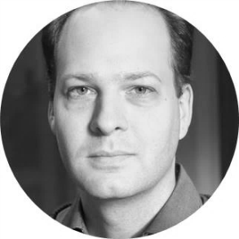

contacts
Jan Schmid
+420 739 202 460
jan.schmid@perfectcrowd.com
Daniel Nádvorník
+420 737 547 766
daniel.nadvornik@perfectcrowd.com

Slide 72

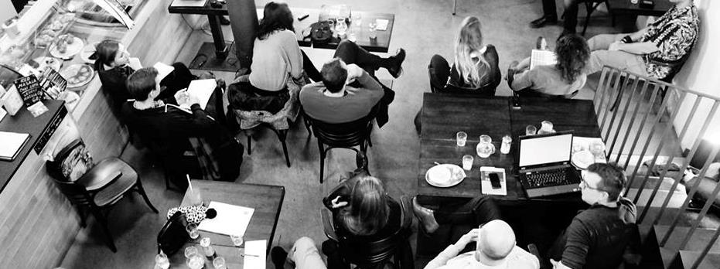
Tusarova 32. Praha 7 170 00
www.perfectcrowd.cz | info@perfectcrowd.com | +420 774 878 771

Slide 73
Confidentiality agreement
The content of this document is confidential as specified in the section 271 of the Czech law No. 513/1991 and the customer is not allowed to reveal the information to any third party or misuse the content for aims not intended in this proposal.
TERMS OF SERVICE
Unless stated otherwise, these terms of condition apply to the proposal and research provided by Perfect Crowd
All respondents remain anonymous to the client and all proposals remain the property of Perfect Crowd company and their content shall not be revealed to any third party.
Complete records of the research remain the property of Perfect Crowd, which is entitled to destroy them one year after the end of the fieldwork. Within this period copies may be obtained on request, at additional cost.
Reports and other records provided by Perfect Crowd are for use only within the Client's organization or its consultants. If wider circulation of results is intended, Perfect Crowd name may not be quoted until the exact form of any public communication has been agreed.
The latest quotation of cost will be regarded as the agreed fee, and will be invoiced on completion of the project. Payments are due within 28 days of invoice date unless otherwise agreed. Quotations are valid for 2 months from the date of issue.
If, at any time, the Client requests that any part of the project be changed, Perfect Crowd company reserves the right to re-quote. If, after commissioning a project, the Client is responsible directly or indirectly for any rearrangement, curtailment or cancellation, the Client shall be liable for all costs incurred.

